Slide 1
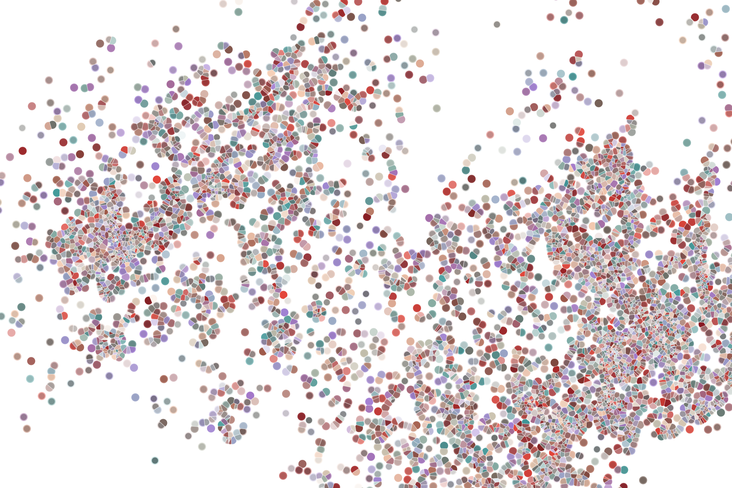
Lecture 8 Inferring cell pseudotime from scRNAseq data
Physalia course 2021 — Single-cell RNA-seq with R/Bioconductor
Instructors: Jacques Serizay
Notes:
Hello everybody and thank you for attending my presentation. I am going to talk about the project I recently started working on in the Spassky and Koszul labs, both located in Paris. This project focuses on the unusual cooption of the mitotic machinery to drive, not cell division but cell differentiation.

Slide 2
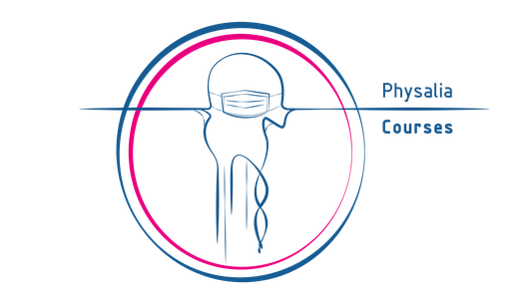
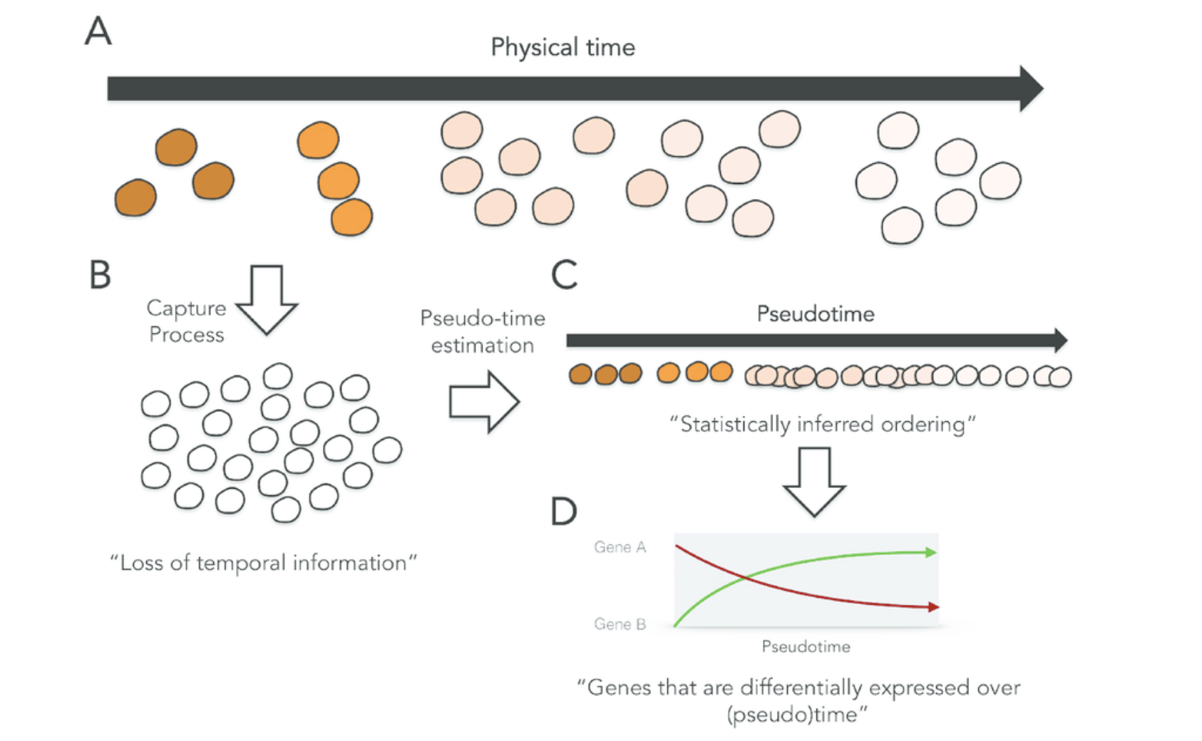
What is pseudotime?
2
Notes:
I would like to expand these observations to in vivo data. I also want to check what happens in terms of transcriptional dynamics in cells where Cyclin O, a key non-canonical cyclin involved in MCC diff., is knocked-out.

Slide 3
What is pseudotime?
Pseudotime is an abstract unit of progress: it's simply the distance between a cell and the start of the trajectory, measured along the shortest path
The trajectory's total length is defined in terms of the total amount of transcriptional change that a cell undergoes as it moves from the starting state to the end state.
Pseudotime is a measure of how much progress an individual cell has made through a process (such as cell differentiation).
http://cole-trapnell-lab.github.io/monocle-release/docs/#constructing-single-cell-trajectories
3
Notes:
I would like to expand these observations to in vivo data. I also want to check what happens in terms of transcriptional dynamics in cells where Cyclin O, a key non-canonical cyclin involved in MCC diff., is knocked-out.

Slide 4
What is pseudotime in single-cell RNA-seq?
In single-cell expression studies of processes such as cell differentiation, captured cells might be widely distributed in terms of progress.
That is, in a population of cells captured at exactly the same time, some cells might be far along, while others might not yet even have begun the process.
By ordering each cell according to its progress along a learned trajectory, pseudotime inference alleviates the problems that arise due to asynchrony.
http://cole-trapnell-lab.github.io/monocle-release/docs/#constructing-single-cell-trajectories
4
Notes:
I would like to expand these observations to in vivo data. I also want to check what happens in terms of transcriptional dynamics in cells where Cyclin O, a key non-canonical cyclin involved in MCC diff., is knocked-out.

Slide 5
What is pseudotime in single-cell RNA-seq?
In single-cell expression studies of processes such as cell differentiation, captured cells might be widely distributed in terms of progress.
That is, in a population of cells captured at exactly the same time, some cells might be far along, while others might not yet even have begun the process.
By ordering each cell according to its progress along a learned trajectory, pseudotime inference alleviates the problems that arise due to asynchrony.
This is why pseudotime and trajectory inference are largely overlapping.
http://cole-trapnell-lab.github.io/monocle-release/docs/#constructing-single-cell-trajectories
5
Notes:
I would like to expand these observations to in vivo data. I also want to check what happens in terms of transcriptional dynamics in cells where Cyclin O, a key non-canonical cyclin involved in MCC diff., is knocked-out.

Slide 6

Analysis workflow
Pre-Processing
Clustering
Trajectory analysis
Expression Matrix
(GENES x CELLS)
1. Identify
Variable Genes
5. Trajectory inference
Filter Cells /
Quality Control
2. Dimensionality Reduction
6. Pseudotime inference
Normalization
3. Clustering
7. DE along trajectory
Notes:
I would like to expand these observations to in vivo data. I also want to check what happens in terms of transcriptional dynamics in cells where Cyclin O, a key non-canonical cyclin involved in MCC diff., is knocked-out.

Slide 7
Analysis workflow
Pre-Processing
Clustering
Trajectory analysis
Expression Matrix
(GENES x CELLS)
1. Identify
Variable Genes
5. Trajectory inference
Filter Cells /
Quality Control
2. Dimensionality Reduction
6. Pseudotime inference
Normalization
3. Clustering
7. DE along trajectory
https://github.com/agitter/single-cell-pseudotime
Notes:
I would like to expand these observations to in vivo data. I also want to check what happens in terms of transcriptional dynamics in cells where Cyclin O, a key non-canonical cyclin involved in MCC diff., is knocked-out.

Slide 8
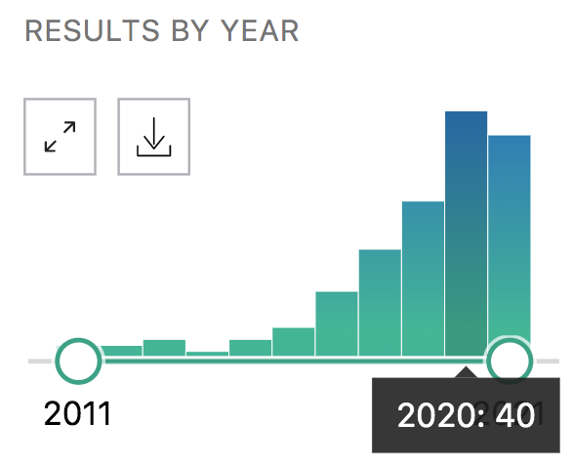
Trajectory inference (TI) tools
A new algorithm comes out almost every week now!
Pubmed results for “trajectory inference method single-cell”:
8
Notes:
I would like to expand these observations to in vivo data. I also want to check what happens in terms of transcriptional dynamics in cells where Cyclin O, a key non-canonical cyclin involved in MCC diff., is knocked-out.

Slide 9
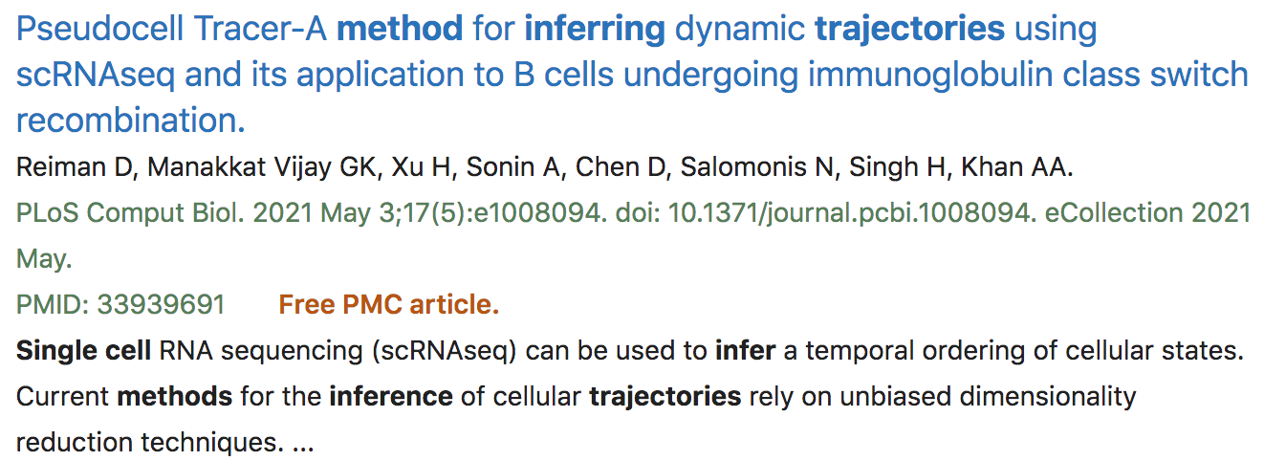
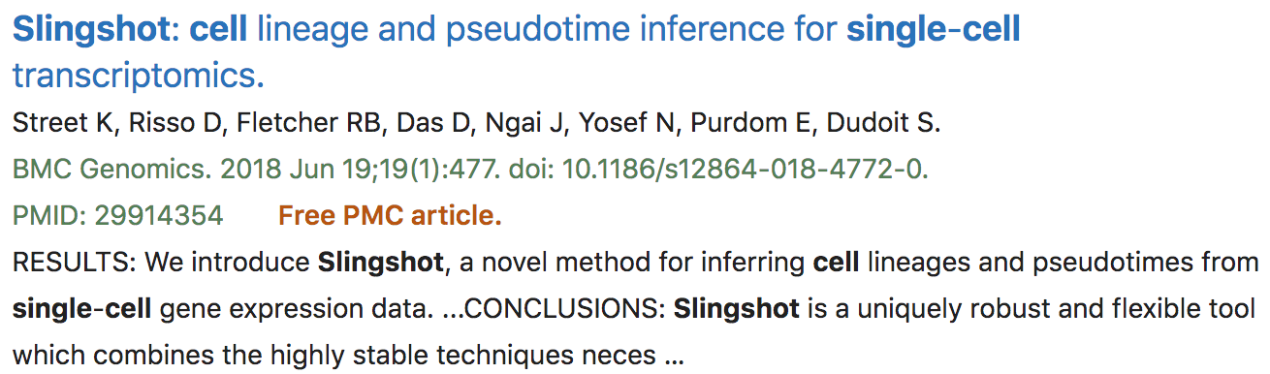
Trajectory inference (TI) tools
A new algorithm comes out almost every week now!
9
Notes:
I would like to expand these observations to in vivo data. I also want to check what happens in terms of transcriptional dynamics in cells where Cyclin O, a key non-canonical cyclin involved in MCC diff., is knocked-out.

Slide 10
Trajectory inference (TI) tools
A new algorithm comes out almost every week now!
10
Notes:
I would like to expand these observations to in vivo data. I also want to check what happens in terms of transcriptional dynamics in cells where Cyclin O, a key non-canonical cyclin involved in MCC diff., is knocked-out.

Slide 11
Trajectory inference (TI) tools
Stick to standards!!
QCed, troubleshooted, optimized and generic
11
Notes:
I would like to expand these observations to in vivo data. I also want to check what happens in terms of transcriptional dynamics in cells where Cyclin O, a key non-canonical cyclin involved in MCC diff., is knocked-out.

Slide 12
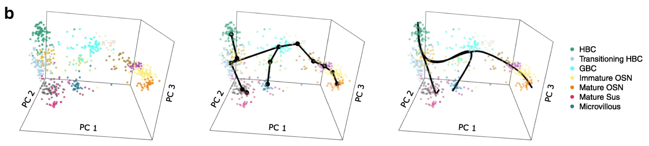
Slingshot
Slingshot is one of the most widely used and robust approaches to infer trajectory in relatively simple datasets.
It works by:
0. Get clustered data in a low-dimensional space
Street et al., 2018
12
Notes:
I would like to expand these observations to in vivo data. I also want to check what happens in terms of transcriptional dynamics in cells where Cyclin O, a key non-canonical cyclin involved in MCC diff., is knocked-out.

Slide 13
Slingshot
Slingshot is one of the most widely used and robust approaches to infer trajectory in relatively simple datasets.
It works by:
0. Get clustered data in a low-dimensional space
Building a minimum spanning tree on the clusters
Street et al., 2018
13
Notes:
I would like to expand these observations to in vivo data. I also want to check what happens in terms of transcriptional dynamics in cells where Cyclin O, a key non-canonical cyclin involved in MCC diff., is knocked-out.

Slide 14
Slingshot
Slingshot is one of the most widely used and robust approaches to infer trajectory in relatively simple datasets.
It works by:
0. Get clustered data in a low-dimensional space
Building a minimum spanning tree on the clusters
Fit principal curves through the MST
Street et al., 2018
14
Notes:
I would like to expand these observations to in vivo data. I also want to check what happens in terms of transcriptional dynamics in cells where Cyclin O, a key non-canonical cyclin involved in MCC diff., is knocked-out.

Slide 15
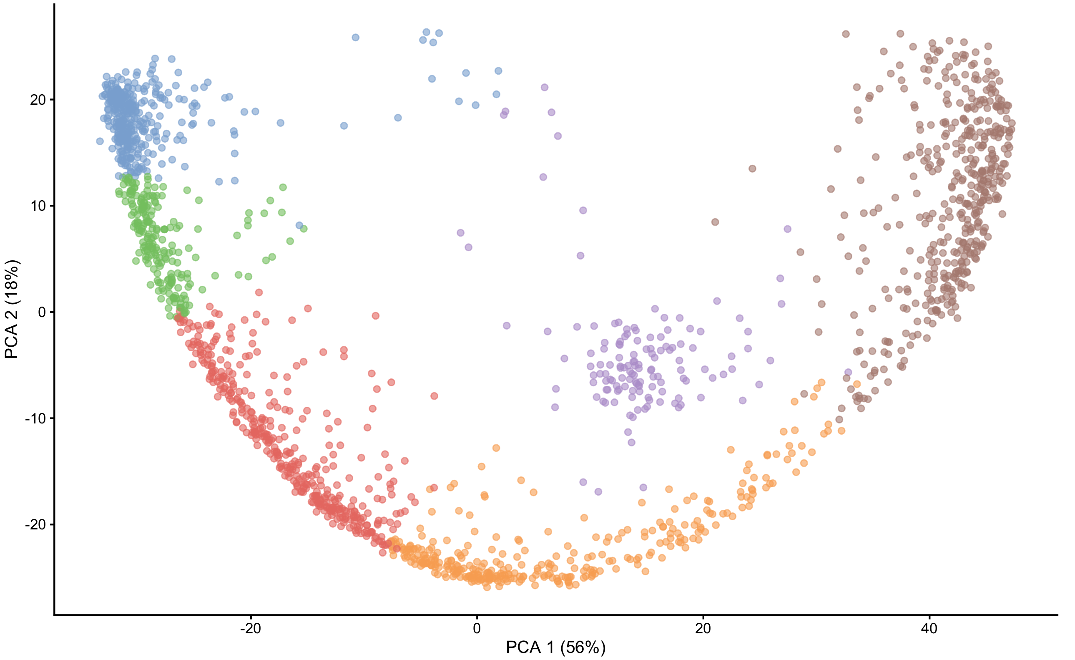
Minimum spanning tree?!?
Or minimum weight spanning tree
Build a graph with edges between each pair of clusters
15
Notes:
I would like to expand these observations to in vivo data. I also want to check what happens in terms of transcriptional dynamics in cells where Cyclin O, a key non-canonical cyclin involved in MCC diff., is knocked-out.

Slide 16
Minimum spanning tree?!?
Or minimum weight spanning tree
Build a graph with edges between each pair of clusters
Add weights to each edge according to proximity of the two clusters
16
1
5
11
14
7
8
2
12
5
2
3
2
16
Notes:
I would like to expand these observations to in vivo data. I also want to check what happens in terms of transcriptional dynamics in cells where Cyclin O, a key non-canonical cyclin involved in MCC diff., is knocked-out.

Slide 17
Minimum spanning tree?!?
Or minimum weight spanning tree
Build a graph with edges between each pair of clusters
Add weights to each edge according to proximity of the two clusters
Find the shortest path between clusters
17
Notes:
I would like to expand these observations to in vivo data. I also want to check what happens in terms of transcriptional dynamics in cells where Cyclin O, a key non-canonical cyclin involved in MCC diff., is knocked-out.

Slide 18
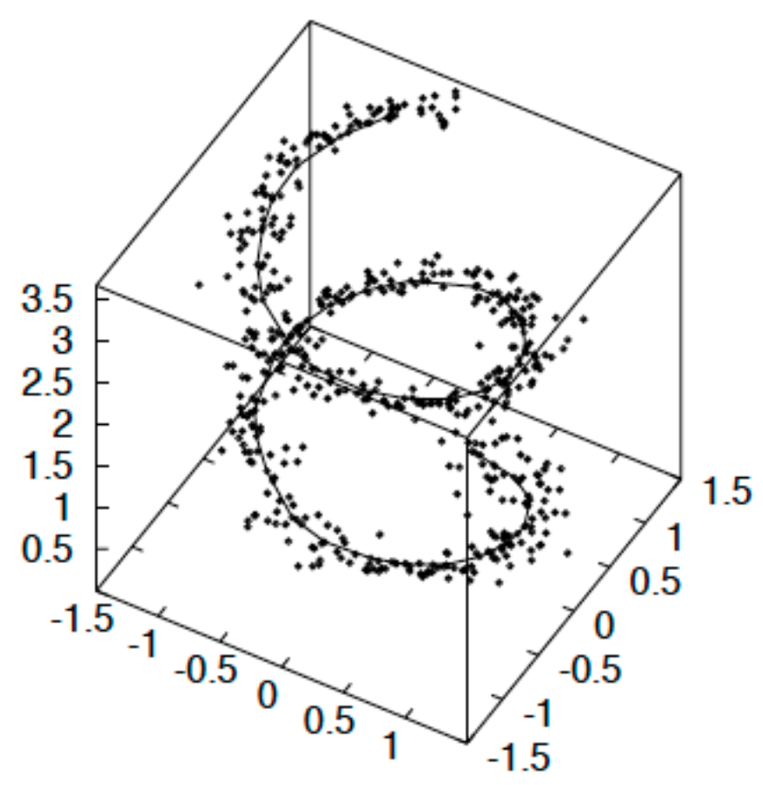
Principal curves?!?
A principal curve is a smooth, one-dimensional, curve that passes through the middle of a high-dimensional data set, providing a nonlinear summary of the data.
18
Notes:
I would like to expand these observations to in vivo data. I also want to check what happens in terms of transcriptional dynamics in cells where Cyclin O, a key non-canonical cyclin involved in MCC diff., is knocked-out.

Slide 19
Principal curves?!?
A principal curve is a smooth, one-dimensional, curve that passes through the middle of a high-dimensional data set, providing a nonlinear summary of the data.
a
a
19
Notes:
I would like to expand these observations to in vivo data. I also want to check what happens in terms of transcriptional dynamics in cells where Cyclin O, a key non-canonical cyclin involved in MCC diff., is knocked-out.

Slide 20
Principal curves?!?
A principal curve is a smooth, one-dimensional, curve that passes through the middle of a high-dimensional data set, providing a nonlinear summary of the data.
CAREFUL: Once again, don’t get tricked by the 2D visualization… Here, the principal curve is computed from 50 PCs, and subsequently embedded in only 2 PCs.
a
a
20
Notes:
I would like to expand these observations to in vivo data. I also want to check what happens in terms of transcriptional dynamics in cells where Cyclin O, a key non-canonical cyclin involved in MCC diff., is knocked-out.

Slide 21
Why clustering quality matters for trajectory inference
The MST is built from cluster centroids. If clustering changes, the MST will change and the fitted principal curves too.
a
a
21
Notes:
I would like to expand these observations to in vivo data. I also want to check what happens in terms of transcriptional dynamics in cells where Cyclin O, a key non-canonical cyclin involved in MCC diff., is knocked-out.

Slide 22
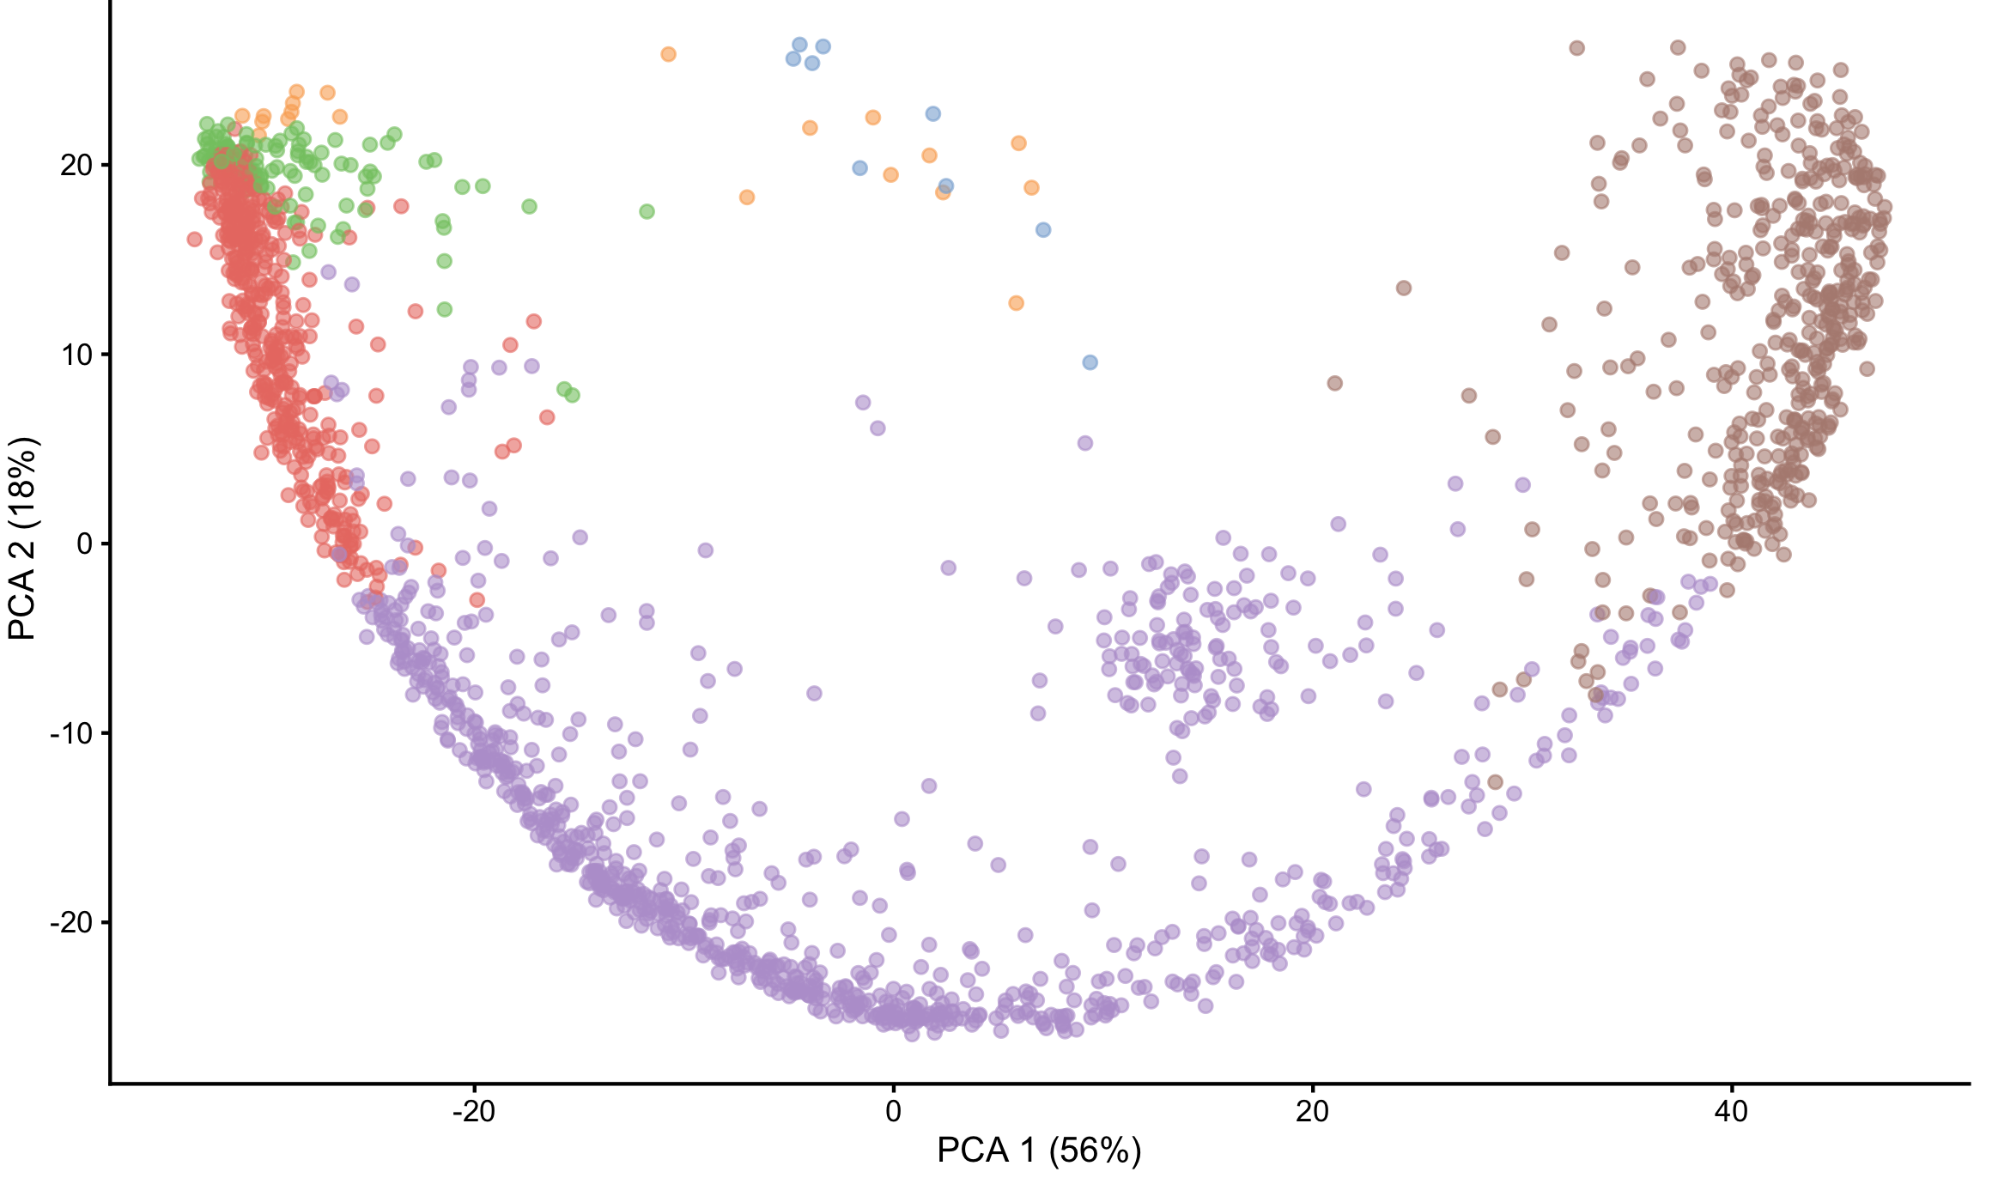
Why clustering quality matters for trajectory inference
The MST is built from cluster centroids. If clustering changes, the MST will change and the fitted principal curves too.
Only perform TI once you are confident your clusters represent a biologically relevant cell population.
a
a
22
Notes:
I would like to expand these observations to in vivo data. I also want to check what happens in terms of transcriptional dynamics in cells where Cyclin O, a key non-canonical cyclin involved in MCC diff., is knocked-out.

Slide 23
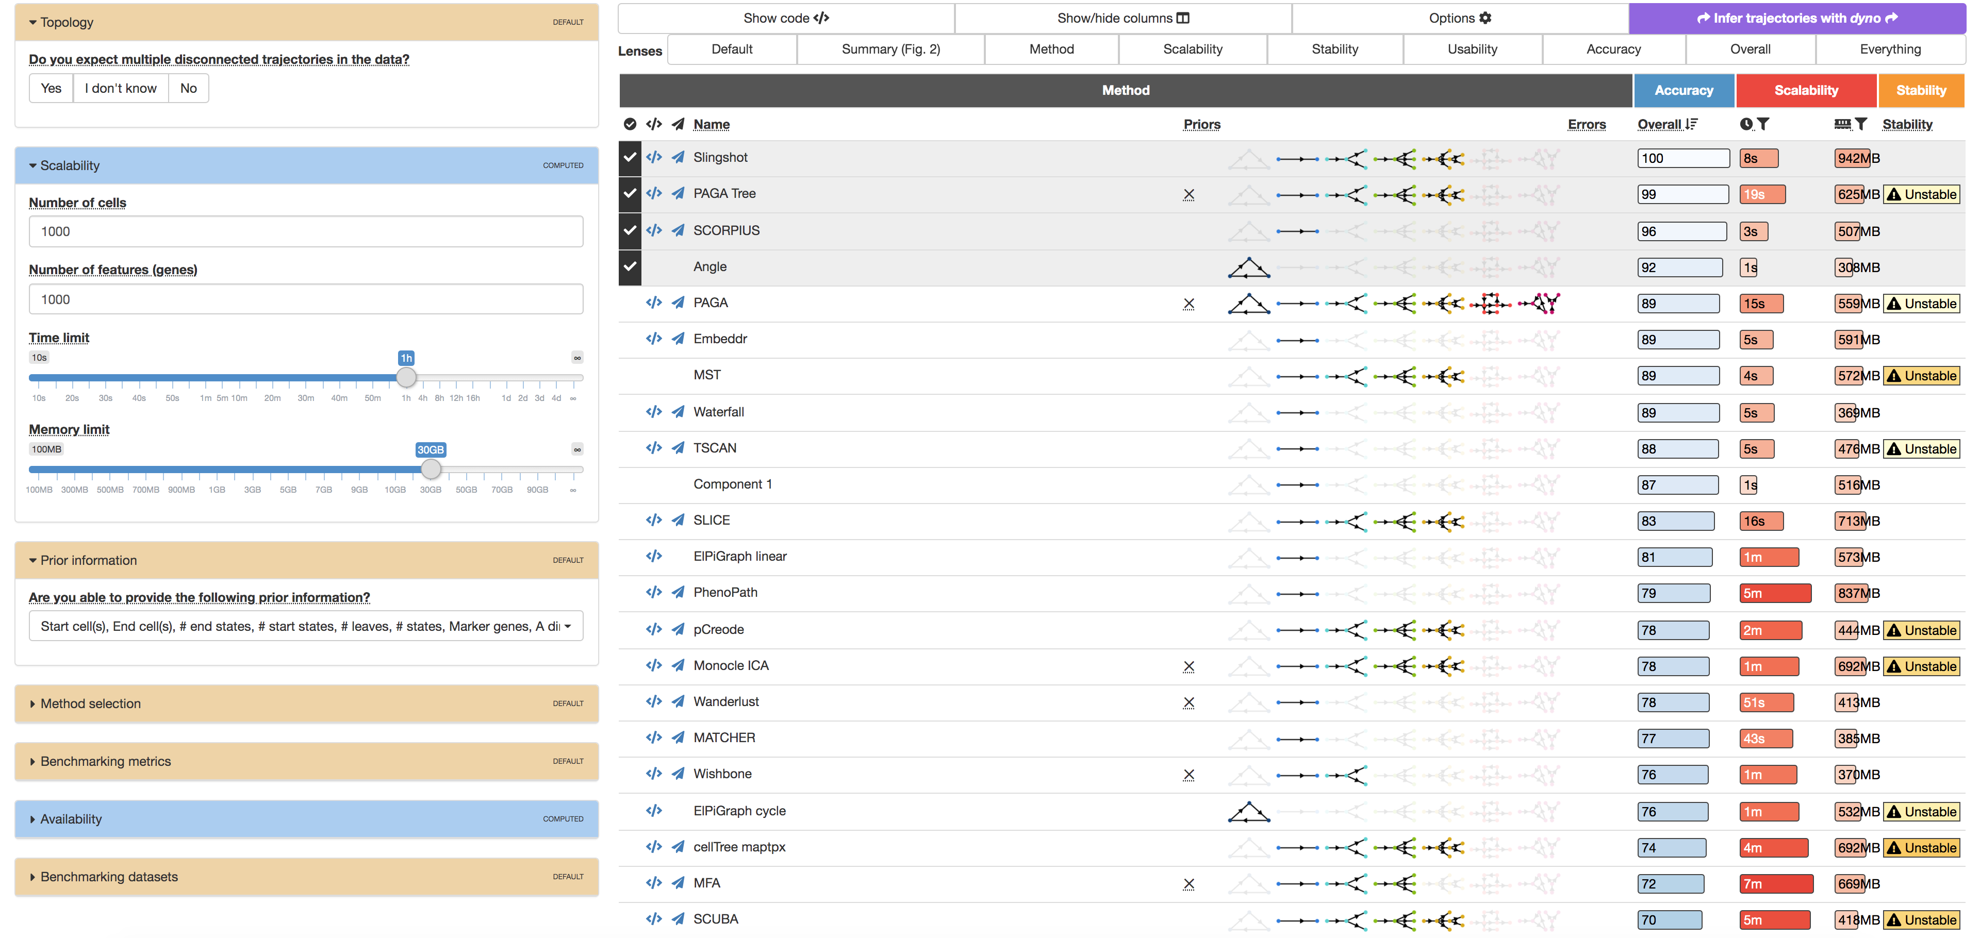
Making sense of all these different methods
Dynverse project provides a handy exploratory/summarizing app to pick the best-suited TI algo.
guidelines.dynverse.org
23
Notes:
I would like to expand these observations to in vivo data. I also want to check what happens in terms of transcriptional dynamics in cells where Cyclin O, a key non-canonical cyclin involved in MCC diff., is knocked-out.

Slide 24
Analysis workflow
Pre-Processing
Clustering
Trajectory analysis
Expression Matrix
(GENES x CELLS)
1. Identify
Variable Genes
5. Trajectory inference
Filter Cells /
Quality Control
2. Dimensionality Reduction
6. Pseudotime inference
Normalization
3. Clustering
7. DE along trajectory
Notes:
I would like to expand these observations to in vivo data. I also want to check what happens in terms of transcriptional dynamics in cells where Cyclin O, a key non-canonical cyclin involved in MCC diff., is knocked-out.

Slide 25
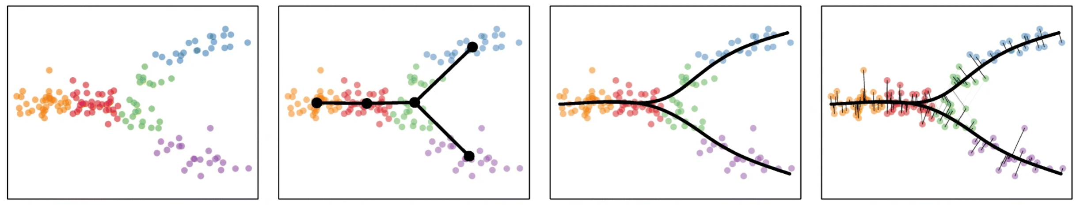
Pseudotime inference
In Slingshot, the pseudotimes values are estimated as the euclidean distance from each point to the closest principal curve (i.e. by orthogonal projection of each point onto the curve).
Street et al., 2018
25
Notes:
I would like to expand these observations to in vivo data. I also want to check what happens in terms of transcriptional dynamics in cells where Cyclin O, a key non-canonical cyclin involved in MCC diff., is knocked-out.

Slide 26
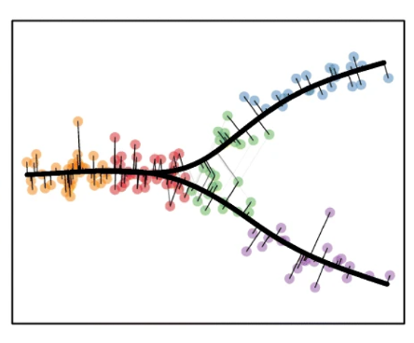
But how are trajectories oriented???
A trajectory is not a vector: a trajectory is not oriented!
This is crucial when estimating pseudotime.
Street et al., 2018
26
Notes:
I would like to expand these observations to in vivo data. I also want to check what happens in terms of transcriptional dynamics in cells where Cyclin O, a key non-canonical cyclin involved in MCC diff., is knocked-out.

Slide 27
But how are trajectories oriented???
A trajectory is not a vector: a trajectory is not oriented!
This is crucial when estimating pseudotime.
That is when one should use prior knowledge, ground-truth, or simply make a call.
Street et al., 2018
27
Notes:
I would like to expand these observations to in vivo data. I also want to check what happens in terms of transcriptional dynamics in cells where Cyclin O, a key non-canonical cyclin involved in MCC diff., is knocked-out.

Slide 28
But how are trajectories oriented???
A trajectory is not a vector: a trajectory is not oriented!
This is crucial when estimating pseudotime.
Hematopoietic stem cell
Lymphoid stem cell
Committed lymphoid stem cell
B cell
T cell
Street et al., 2018
28
Notes:
I would like to expand these observations to in vivo data. I also want to check what happens in terms of transcriptional dynamics in cells where Cyclin O, a key non-canonical cyclin involved in MCC diff., is knocked-out.

Slide 29
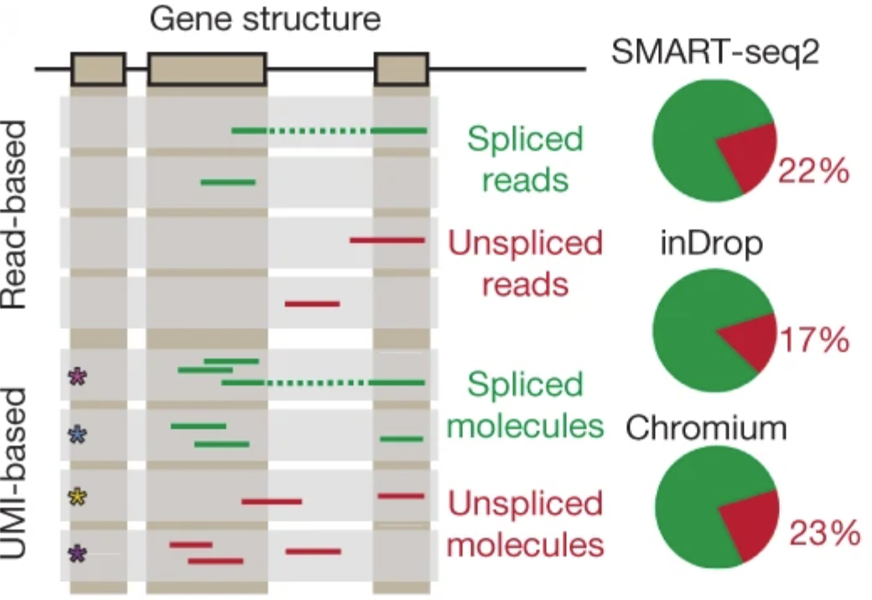
RNA velocity
Single-cell RNA-seq reads can be mapped onto exons or introns.
La Manno et al., 2018
29
Notes:
I would like to expand these observations to in vivo data. I also want to check what happens in terms of transcriptional dynamics in cells where Cyclin O, a key non-canonical cyclin involved in MCC diff., is knocked-out.

Slide 30
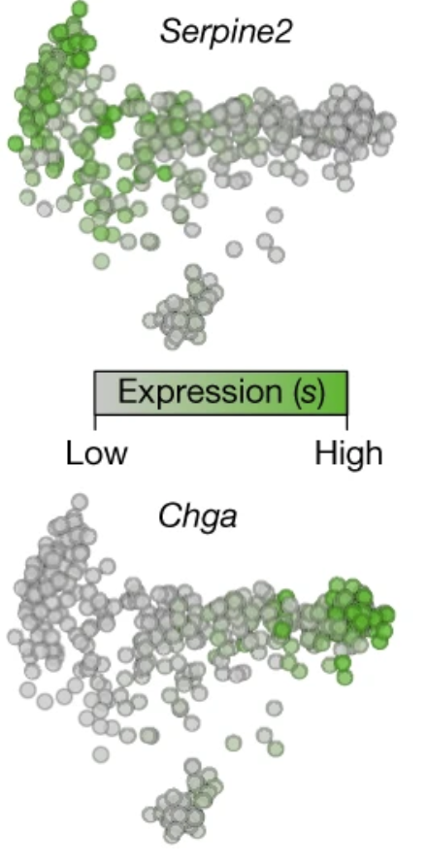
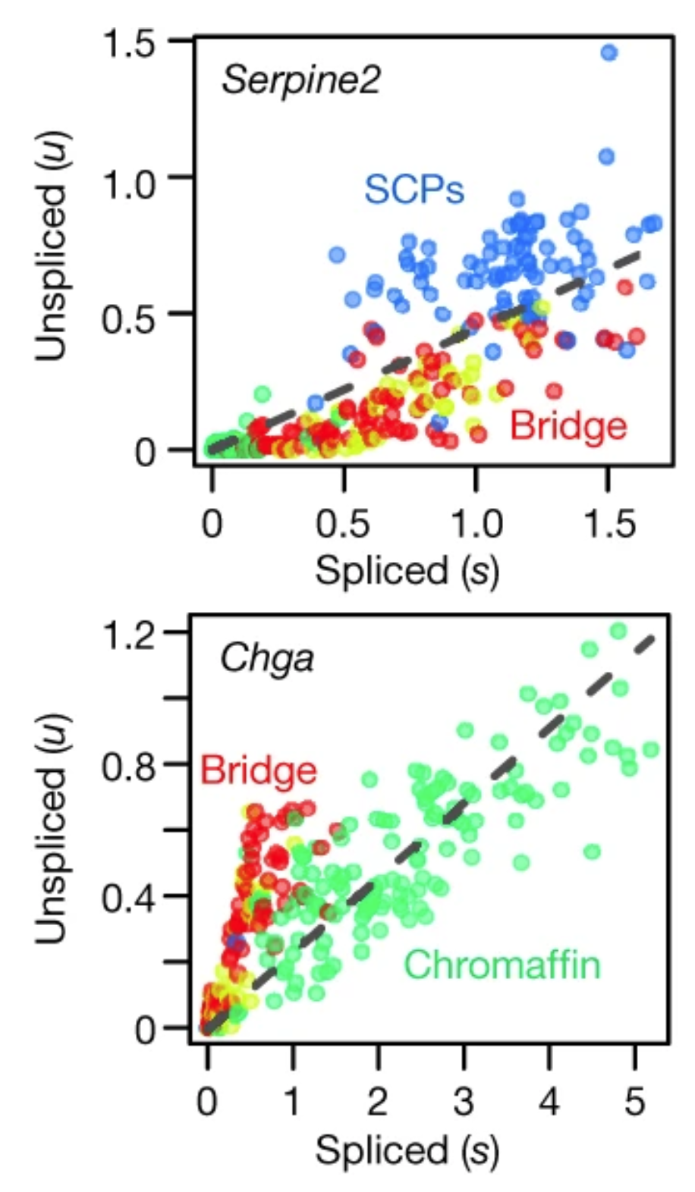
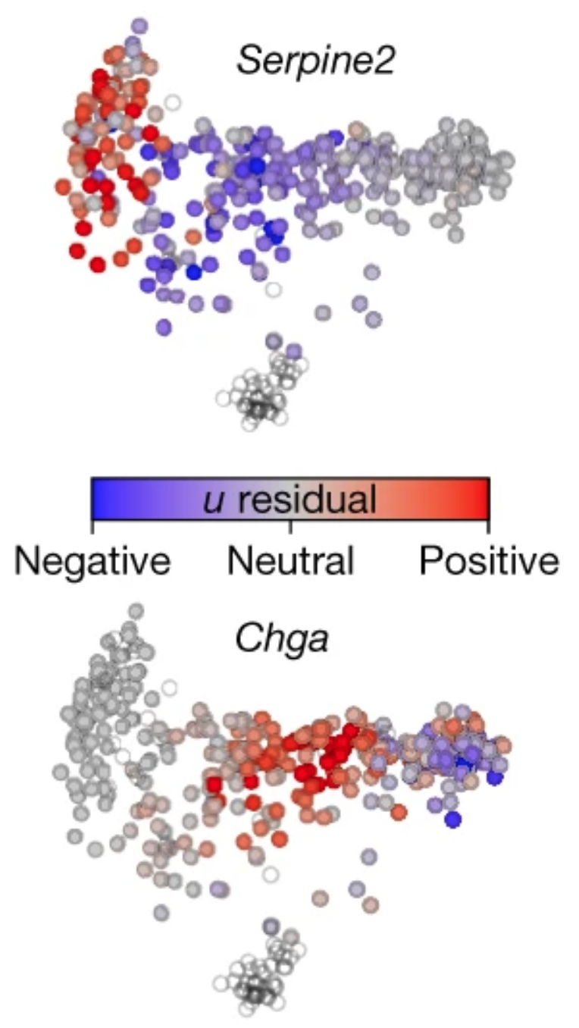
RNA velocity
u residual represents whether the cell is far from an equilibrium state of expression
La Manno et al., 2018
30
Notes:
I would like to expand these observations to in vivo data. I also want to check what happens in terms of transcriptional dynamics in cells where Cyclin O, a key non-canonical cyclin involved in MCC diff., is knocked-out.

Slide 31
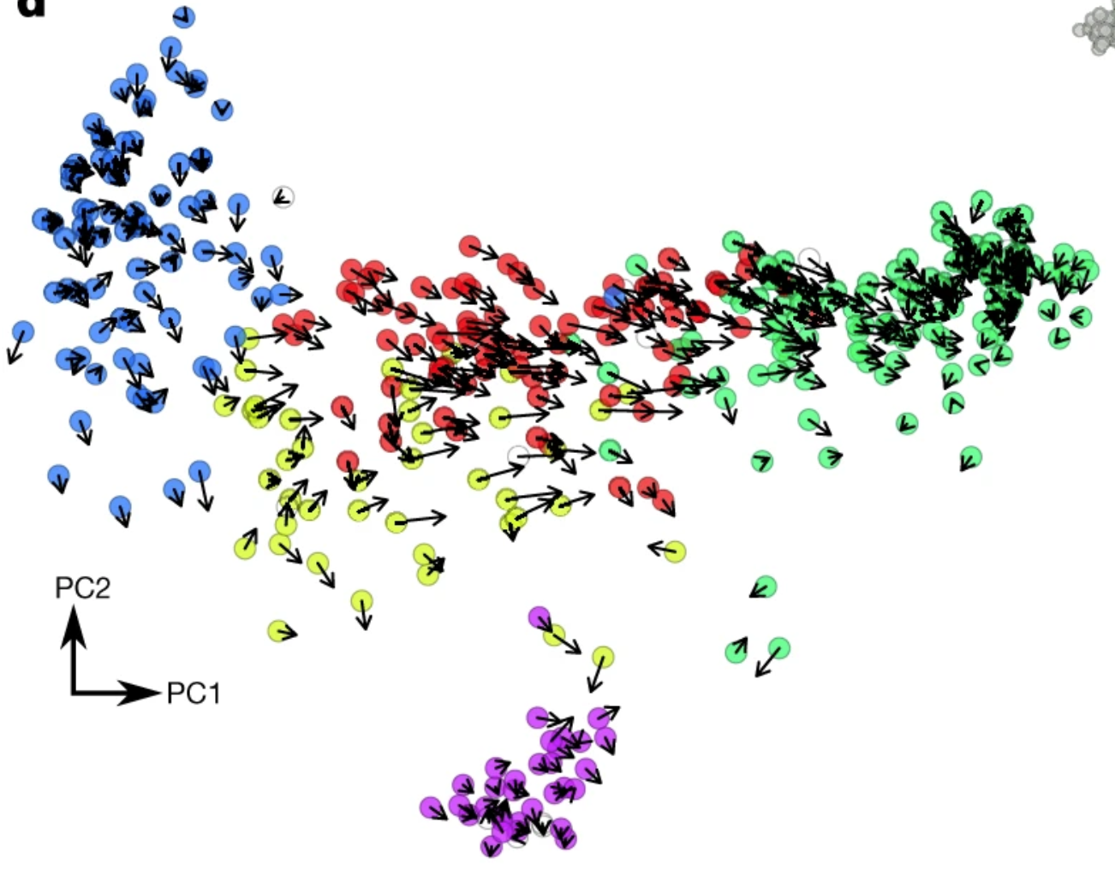
RNA velocity
Generalizing this to all the detected (variable) genes, one can infer the future ”position” of each cell.
La Manno et al., 2018
31
Notes:
I would like to expand these observations to in vivo data. I also want to check what happens in terms of transcriptional dynamics in cells where Cyclin O, a key non-canonical cyclin involved in MCC diff., is knocked-out.

Slide 32
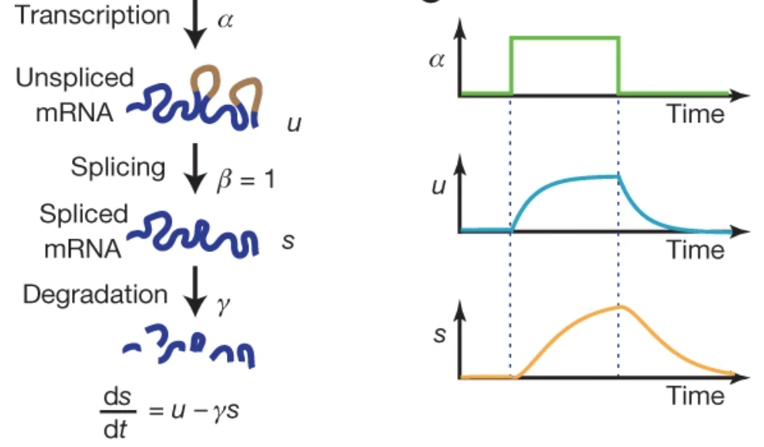
RNA velocity
Generalizing this to all the detected (variable) genes, one can infer the future ”position” of each cell.
CAREFUL!!!
This model relies on an important assumption:
that transcription is steady-state.
This is rarely true, even less true for differentiating cells!!
La Manno et al., 2018
32
Notes:
I would like to expand these observations to in vivo data. I also want to check what happens in terms of transcriptional dynamics in cells where Cyclin O, a key non-canonical cyclin involved in MCC diff., is knocked-out.

Slide 33
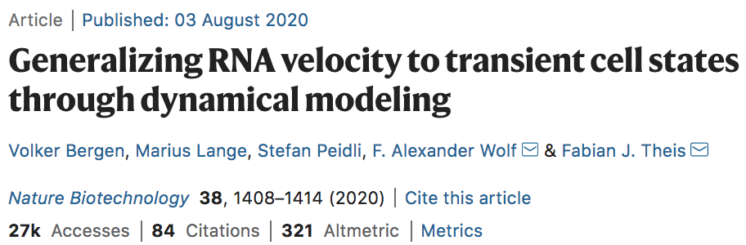
RNA velocity generalized to non-steady-state cell populations
Bergen et al., 2020
33
Notes:
I would like to expand these observations to in vivo data. I also want to check what happens in terms of transcriptional dynamics in cells where Cyclin O, a key non-canonical cyclin involved in MCC diff., is knocked-out.

Slide 34
Using RNA velocity to infer directionality of the trajectory
34

Slide 35
Using RNA velocity to infer directionality of the trajectory
RNA velocity implementations generally output a pseudotime value. However, they do not infer trajectories!! So they cannot capture a branching event, or cycles, etc….
35

Slide 36
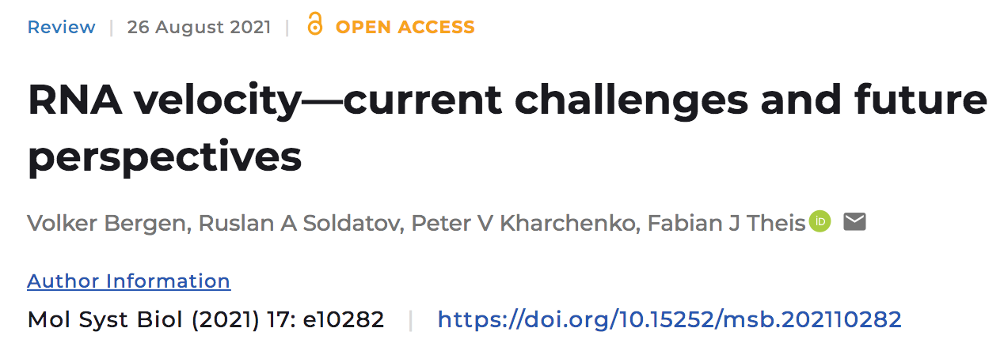
RNA velocity: CURRENT CHALLENGES and future perspectives
“The concept of RNA velocity (La Manno et al, 2018) has unlocked new ways of studying cellular dynamics by granting access to not only the descriptive state of a cell, but also to its direction and speed of movement in transcriptome space, thereby enabling predictive models of cell dynamics […]. The combination of velocities across genes is then used to estimate the future state of an individual cell.”
36

Slide 37
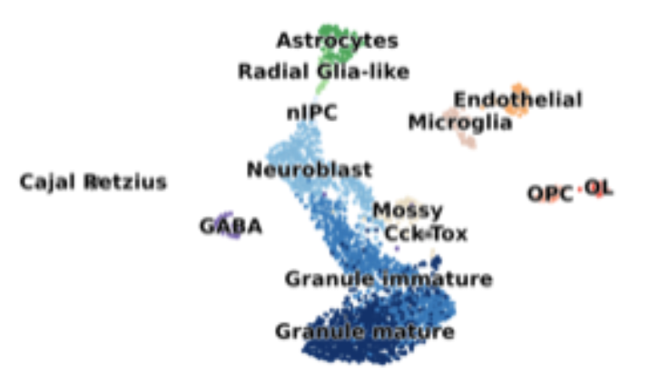
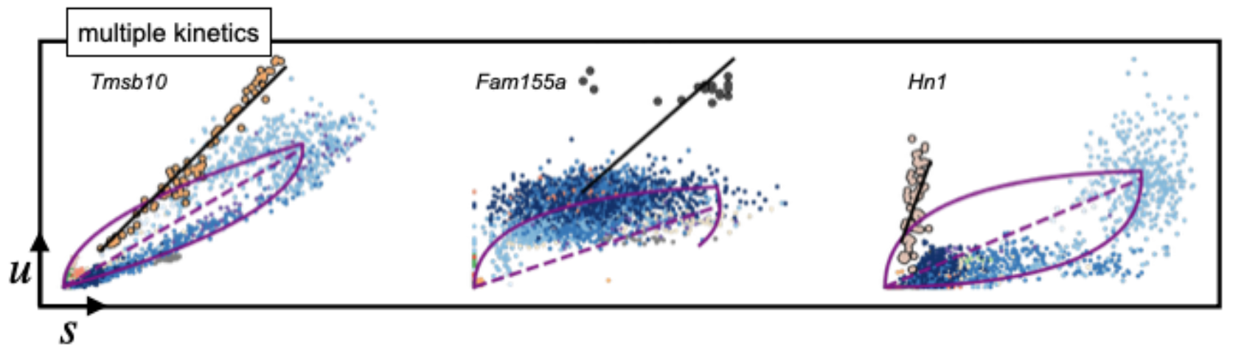
RNA velocity: CURRENT CHALLENGES and future perspectives
Some genes show multiple kinetic regimes across subpopulations and lineages
Bergen et al., Mol Biol System 2021
37

Slide 38
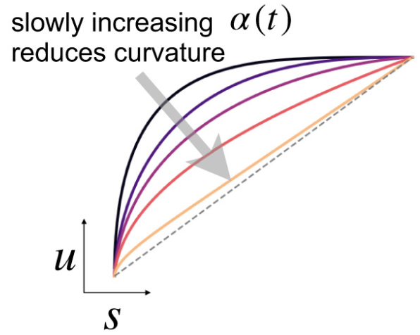
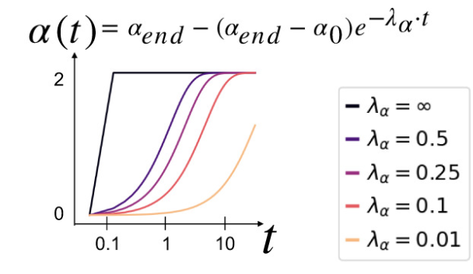
RNA velocity: CURRENT CHALLENGES and future perspectives
Some genes show multiple kinetic regimes across subpopulations and lineages
Time-dependent gene kinetic rates impact the curvature patterns of gene activation
Bergen et al., Mol Biol System 2021
38

Slide 39
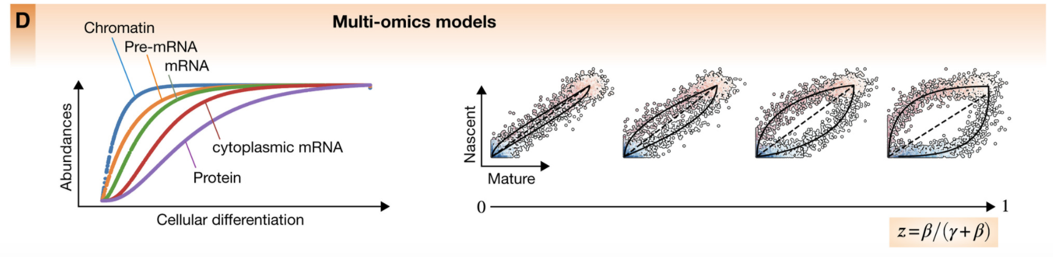
RNA velocity: CURRENT CHALLENGES and future perspectives
Multi-(transcript)omics to the rescue
Bergen et al., Mol Biol System 2021
39

Slide 40
Analysis workflow
Pre-Processing
Clustering
Trajectory analysis
Expression Matrix
(GENES x CELLS)
1. Identify
Variable Genes
5. Trajectory inference
Filter Cells /
Quality Control
2. Dimensionality Reduction
6. Pseudotime inference
Normalization
3. Clustering
7. DE along trajectory
https://github.com/agitter/single-cell-pseudotime
Notes:
I would like to expand these observations to in vivo data. I also want to check what happens in terms of transcriptional dynamics in cells where Cyclin O, a key non-canonical cyclin involved in MCC diff., is knocked-out.

Slide 41
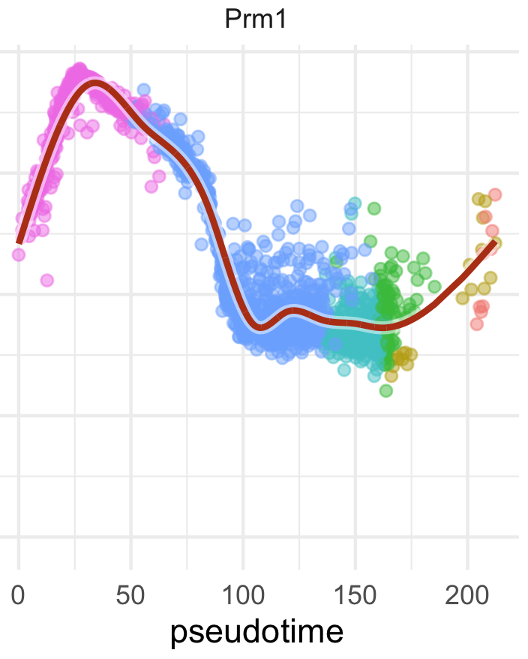
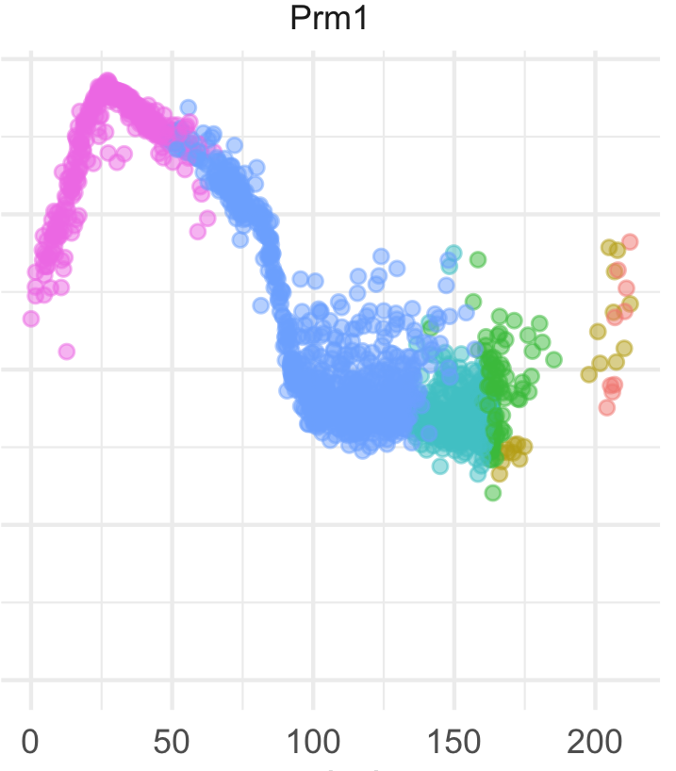
Modeling gene expression along pseudotime
With a pseudotime value inferred to each cell, one can place all cells along an x axis, and plot gene expression on an y axis.
41

Slide 42
Modeling gene expression along pseudotime
With a pseudotime value inferred to each cell, one can place all cells along an x axis, and plot gene expression on an y axis.
Then time-dependent expression can be modelled, typically by fitting a GAM to the gene expression ~ pseudotime.
42

Slide 43
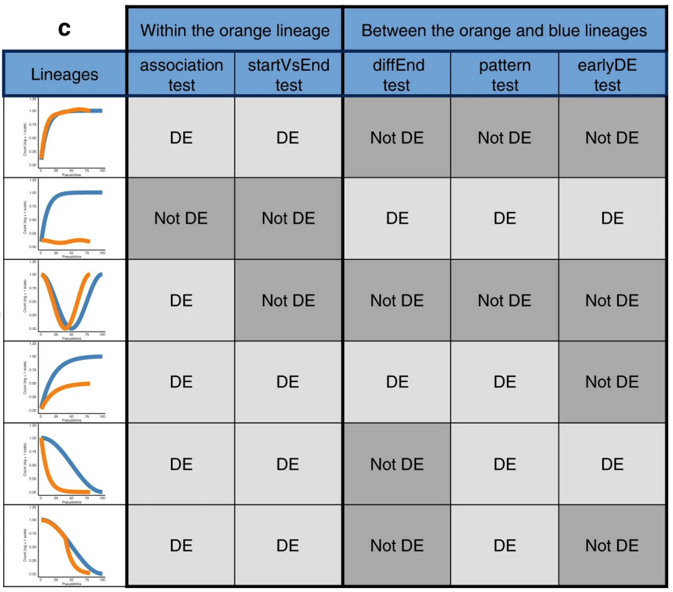
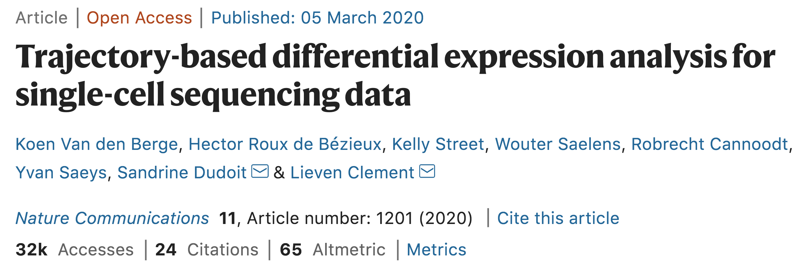
Performing temporal DE gene analysis
tradeSeq is an R package which facilitates GAM-fitting and gene DE analysis along and between trajectories.
It implements plug-and-play methods to use outputs from Slingshot, but most functions can be used directly with pseudotime values, without having to rely on trajectories specifically inferred with Slingshot.
Van den Berge et al., 2020
43

